Slide 1
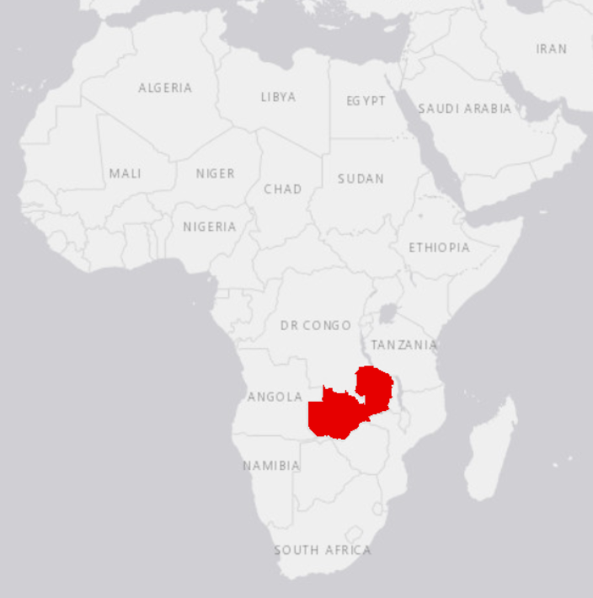
Streamflow Gage
Temperature Gage
Precipitation Gage
Itezhi Tezhi
Kafue Gorge

Slide 2
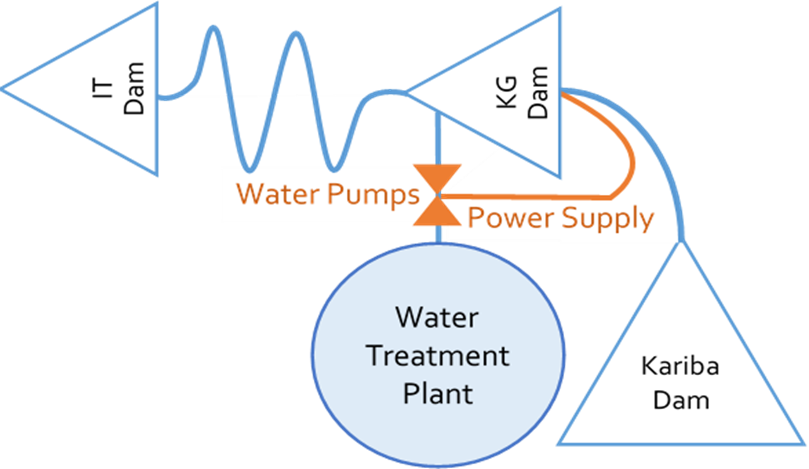
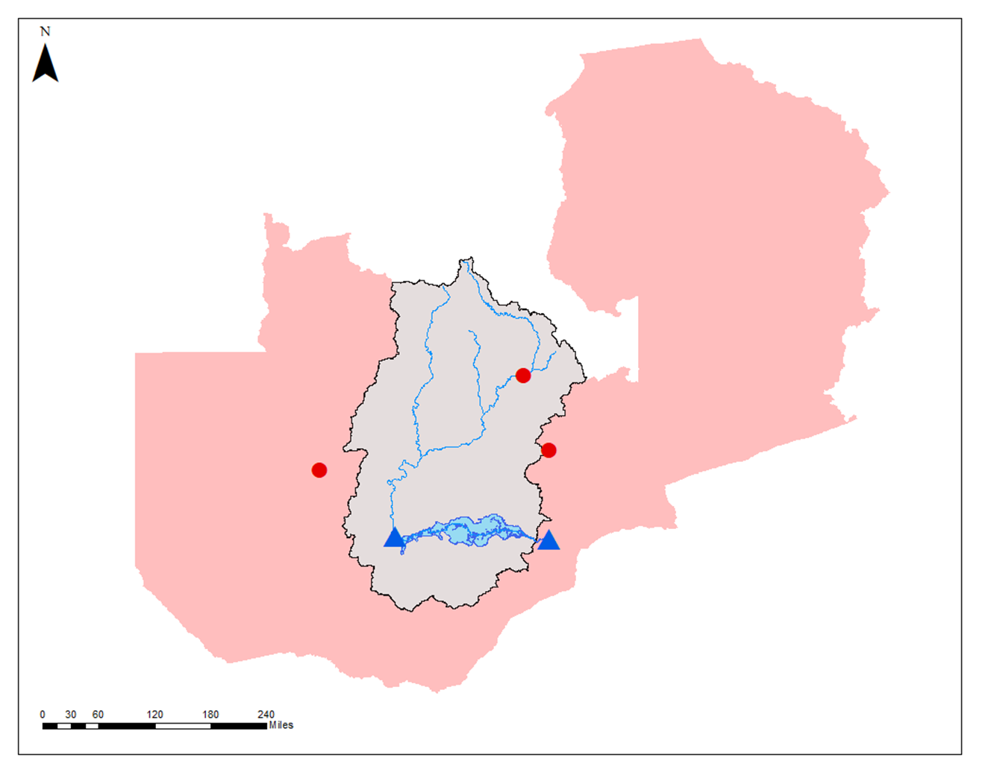

Slide 3
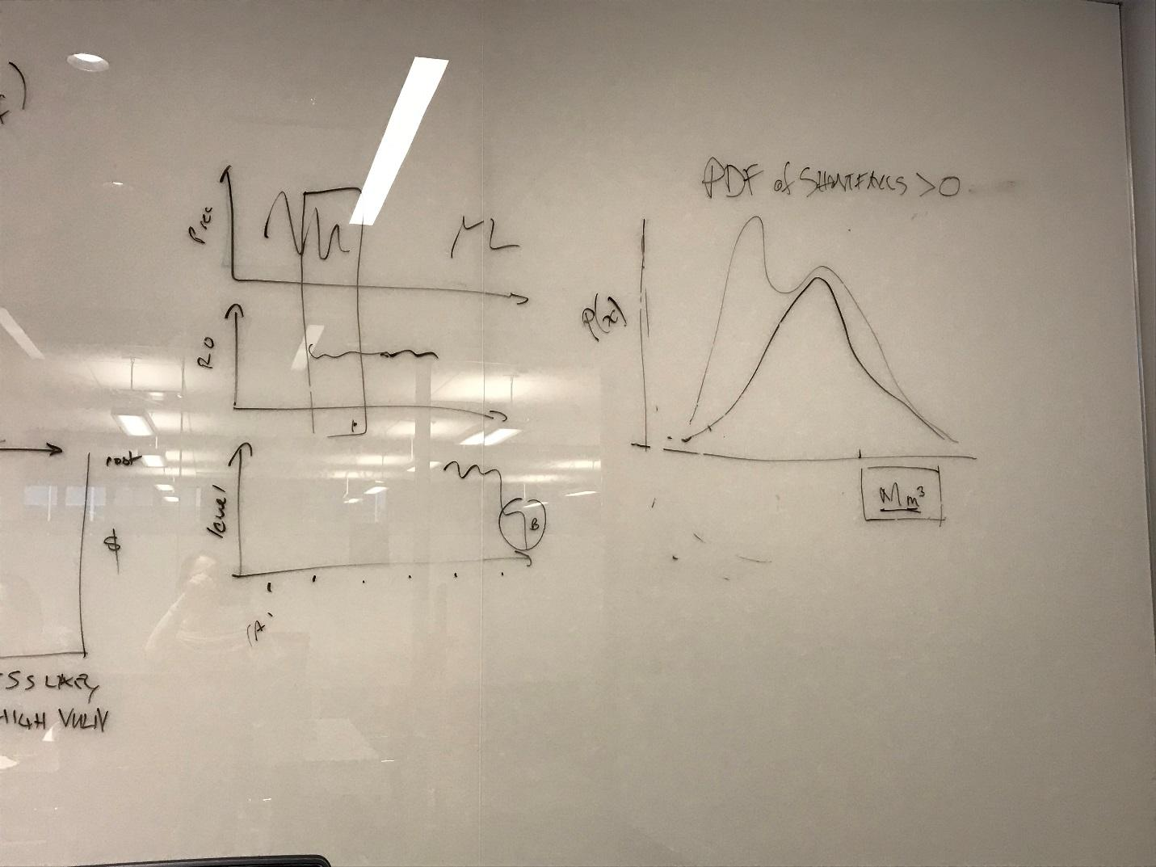
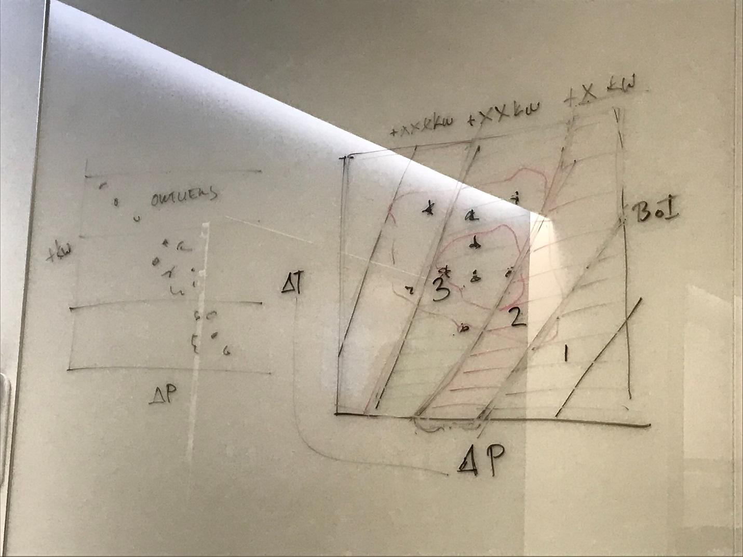
GCM-based Perturbations
INPUTS
Streamflow Model
Reservoir Model
Iolanda Plant Model
Bootstrapped precipitation, temperature
System Parameters

Slide 4
Power Path
Kafue River
Water Path
LUSAKA
IRRIGATION?
IOLANDA PLANT
BOOSTER
ITEZHI TEZHI
Iolanda WTP
IRRIGATION
Kafue River
Power Station
KAFUE GORGE
Power Station
Kafue Flats
KARIBA RESERVOIR
Zambezi River
Zambezi River
Power Station

Slide 5
CLIMATIC INPUTS (monthly):
Byduko Streamflow Model data inputs:
Precipitation (1961-1990)
Upstream streamflow (1980-1984)
Max & Min Air Temp (1973-2001)
GCM (now RCP) projections
CHARACTERISITIC INPUTS:
Reservoir/Hydropower Characteristics
Drainage basin area/characteristics
INPUTS (WTP):
Pump capacities*
Storage/booster tank volumes*
Population served/water use*
LUSAKA
IOLANDA PLANT
BOOSTER
Iolanda WTP
ITEZHI TEZHI
WTP
MODEL OUTPUTS:
Monthly dist. of unmet demand:
KG → Iolanda
Iolanda → Lusaka
Monthly dist. lost Iolanda revenue
KAFUE GORGE
INPUT WATER DEMANDS (monthly):
HYD
E-flow
Irrigation
HYD
Power Station
INPUTS (monthly):
Local inflows from portion of basin between reservoirs
Portion of Outflow from Itezhi Tezhi
(E-flow + HYD + Spillway)
Water demands
E-flow
Irrigation
Iolanda WTP
E-flow
Power Station
HYD
OUTPUT RELEASES (monthly):
HYD
E-flow
Irrigation
Spillway
SPILLWAY
E-flow
SPILLWAY
OUTPUTS RELEASES (monthly):
HYD
E-flow
Irrigation
Spillway
WTP
IRRIGATION
*User-Modifiable actions
IRRIGATION

Slide 6
Mwelwa-Mutekenya (2004)

Slide 7
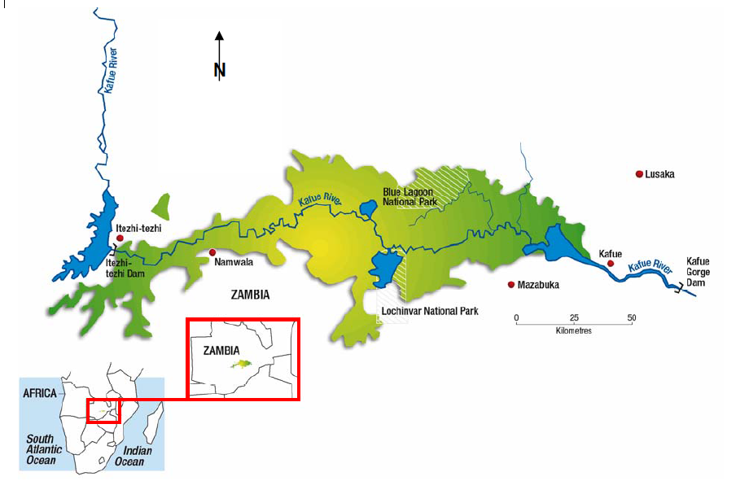
Godet and Pfister (2007)

Slide 8
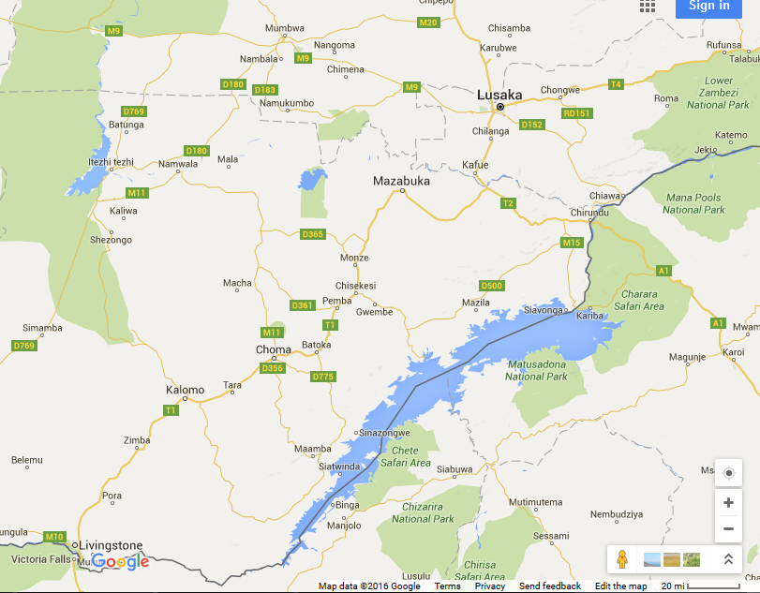
ITEZHI TEZHI
KAFUE GORGE
KARIBA

Slide 9
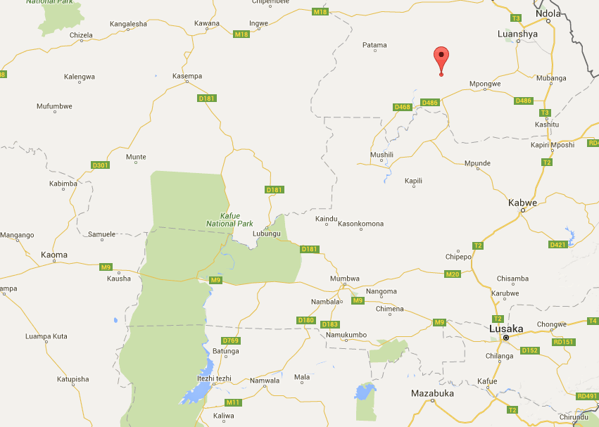
Nduben Streamflow Station
Kabwe Temp Gage
Kaoma Rain Gage
Kafue Gorge Dam
Itezhi Tezhi Dam

Slide 10
Mwelwa-Mutekenya (2004)

Slide 11
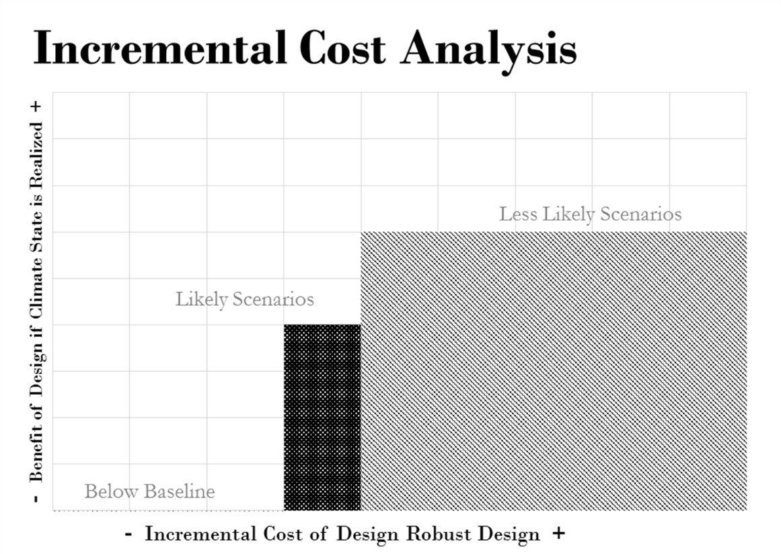
- Projected Scenario Benefits +
- Generator Plan Costs +
+ 6500 kW
+ 4500 kW
+ o kW

Slide 12
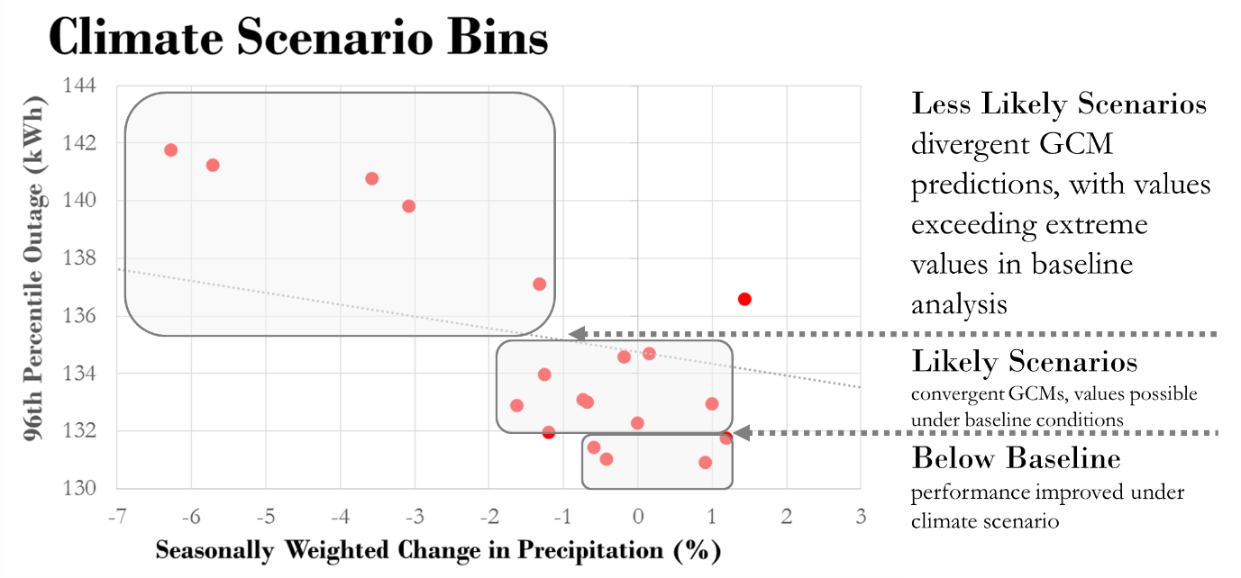
96th Percentile Monthly Power Shortfall (kWh)
GCM Mean Monthly Precipitation Change (%)

Slide 13
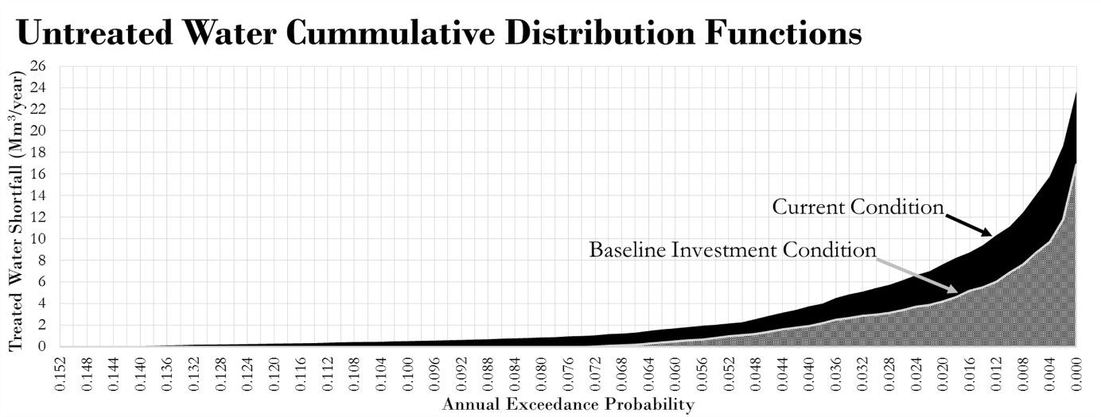
Treated Water Shortfall (Mm³/yr)
Likelihood of water shortfall of equal or greater value

Slide 14
